Slide 1
Privacy-Preserving Machine Learning with Fully Homomorphic Encryption

Slide 2
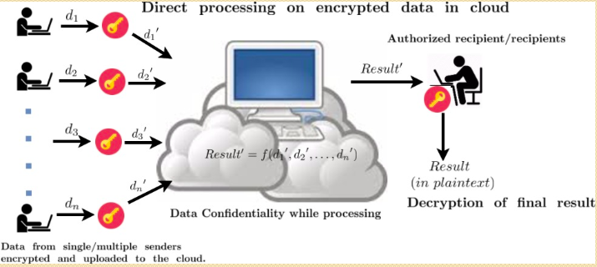
The privacy-preserving issue is one of the most practical problems for machine learning recently.
Fully homomorphic encryption (FHE) is one appropriate tool for privacy-preserving machine learning (PPML) to ensure strong security in the cryptographic sense.

Slide 3
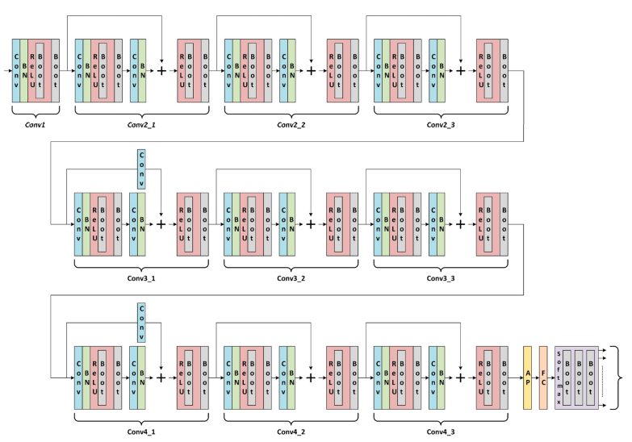
Resnet 20: How to compute in ciphertext domain?

Slide 4
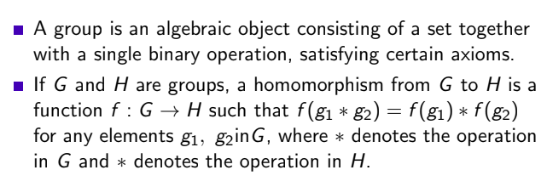
What is homomorphism?

Slide 5
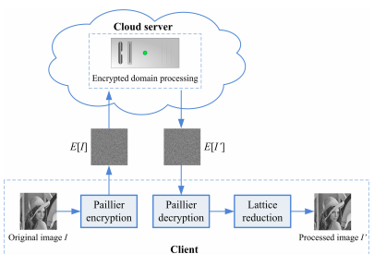
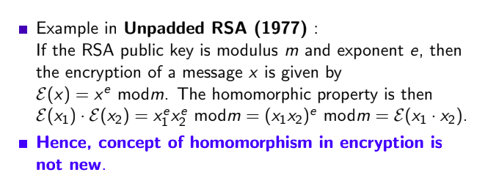
Homomorphism and Encryption

Slide 6
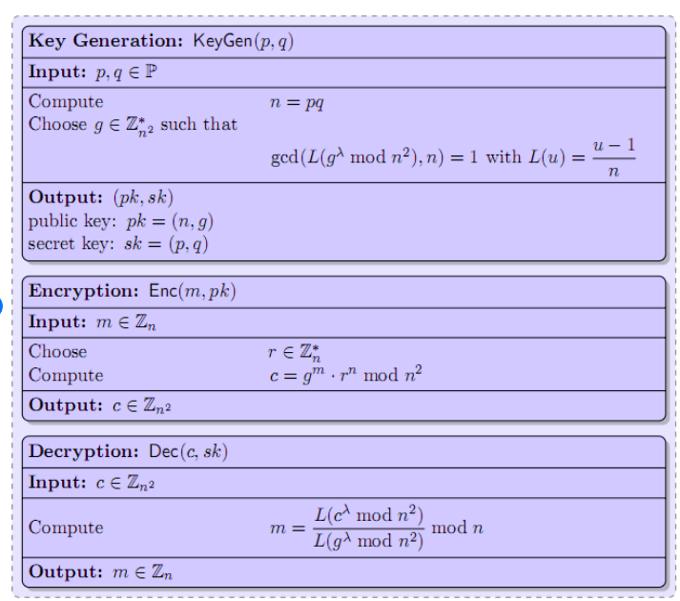
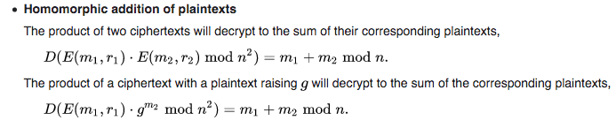
Paillier Encryption

Slide 7
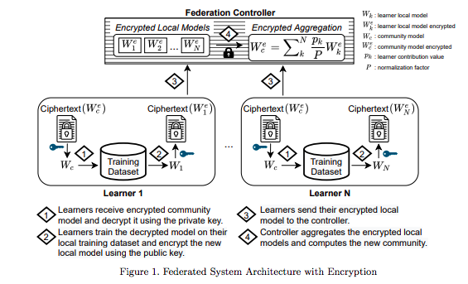
Application in Federated Learning*
*Secure Neuroimaging Analysis using Federated Learning with Homomorphic Encryption, SIPAIM 2021

Slide 8
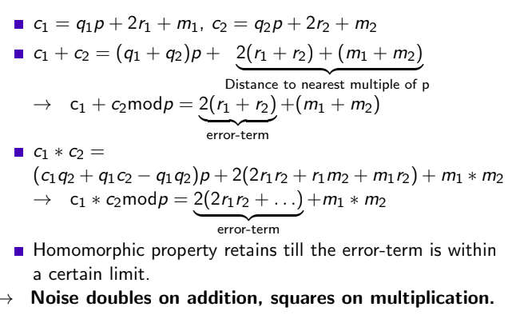
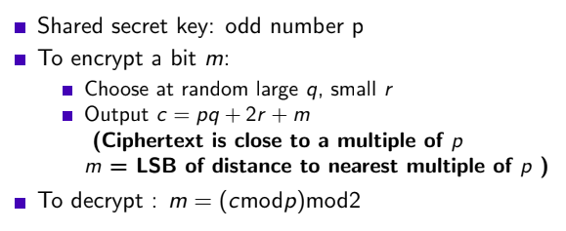
Concept of Fully Homomorphic Encryption

Slide 9
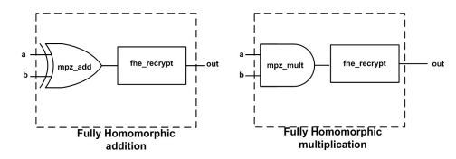
Concept of Fully Homomorphic Encryption
Restrict Noise
Bootstrap after each operation [keep noise within a certain limit]
Support homomorphic addition and multiplication
That will support arbitrary operations
Performance and Feasibility??

Slide 10
Summary
FHE is an encryption scheme whose ciphertexts can be processed with any deep Boolean circuits or arithmetic circuits without access to the data.
The security of FHE has been usually defined with indistinguishability under chosen-plaintext attack (IND-CPA) security, which is a standard cryptographic security definition.
If the client sends the public keys and the encrypted data with an FHE scheme to the PPML server, the server can perform all computation needed in the desired service before sending the encrypted output to the client.
Challenge/limitation: Performance and feasibility

Slide 11
Applications

Slide 12
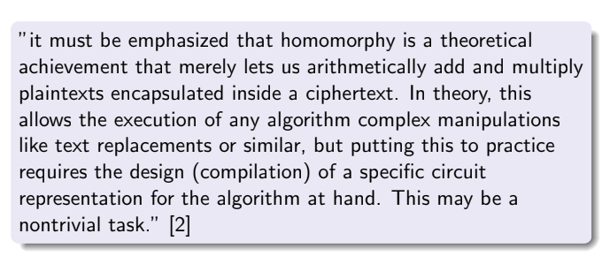
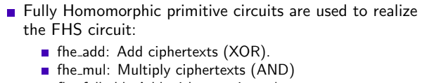
Support from FHE Libraries

Slide 13
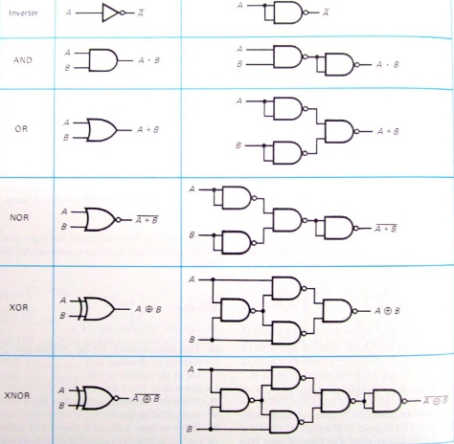
Arbitrary Operations
A universal gate is a gate which can implement any Boolean function without need to use any other gate type.
The NAND and NOR gates are universal gates.

Slide 14
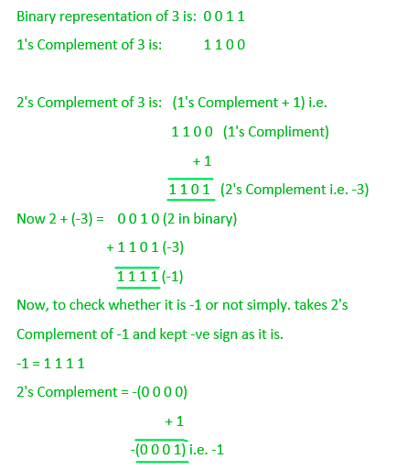
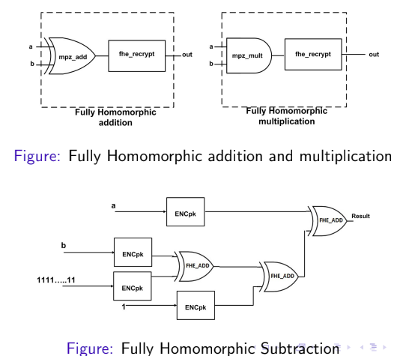

Slide 15
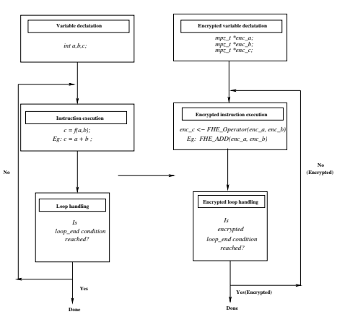

Slide 16
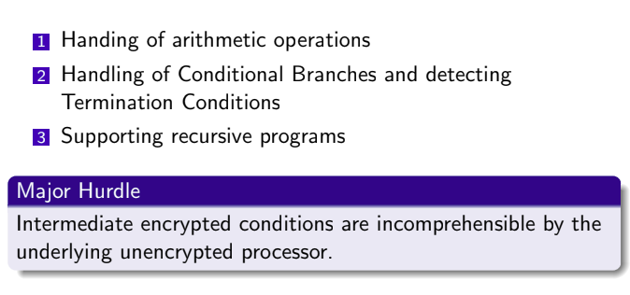

Slide 17
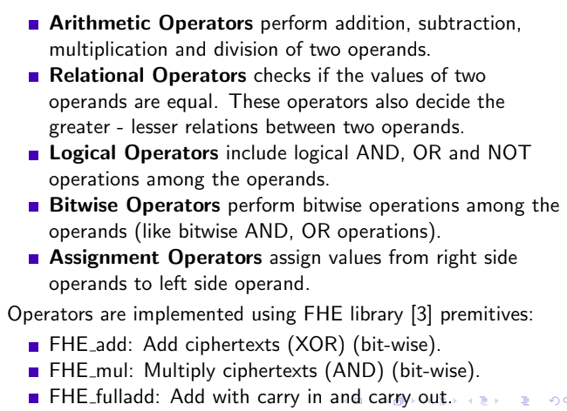

Slide 18
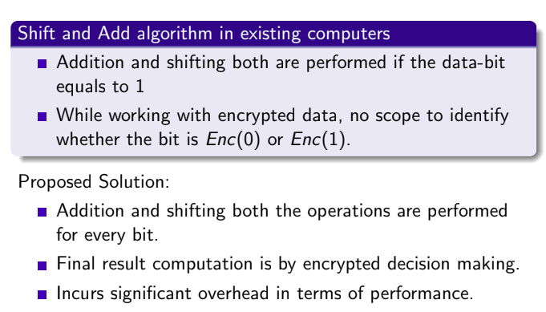
Few Challenges

Slide 19
Encrypted DNN*
https://ieeexplore.ieee.org/document/9920696

Slide 20
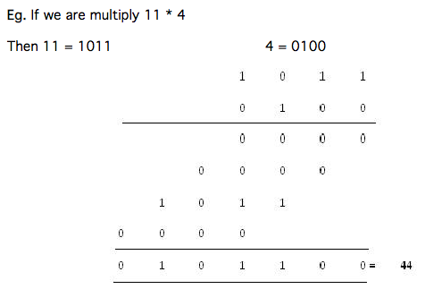
Revisit Convolution: Multiplication

Slide 21
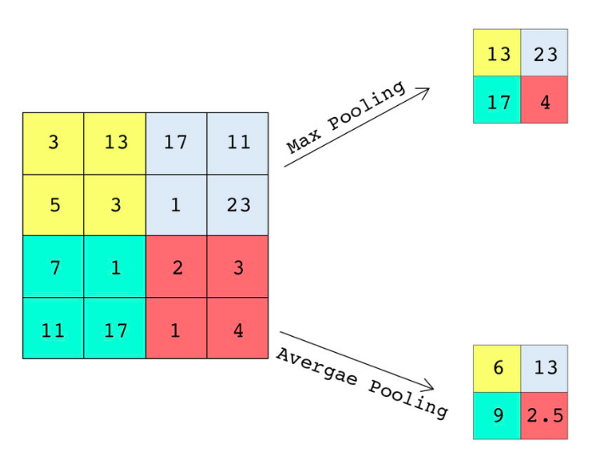
MaxPooling/ Average Pooling
Plaintext domain:
Average pooling method smooths out the image and hence the sharp features may not be identified when this pooling method is used.
Max pooling selects the brighter pixels from the image. It is useful when the background of the image is dark and we are interested in only the lighter pixels of the image.
Encrypted domain:
Max pooling is costlier now than average pooling (was mentioned not feasible as mentioned in this 2016 paper )

Slide 22

ReLU
The sigmoid and the rectified linear activation functions are non-polynomial functions.
One way is to approximate these functions with low-degree polynomials.
chose to use the lowest-degree non-linear polynomial function, which is the square function: sqr(z) := z^2 .
This limitation increases overfitting

Slide 23
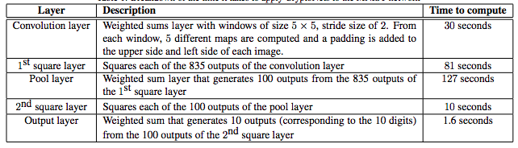
Result
Compare this timing requirement with plaintext timing

Slide 24
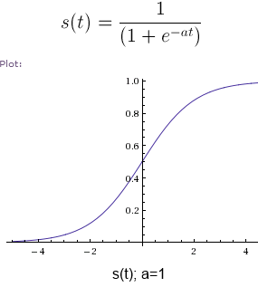
Open Challenge: 1. Sigmoid Layer
The sigmoid activation function is necessary for the training stage in order to get reasonable error terms when running the gradient descent algorithm.
However, there is no good way of dealing with the sigmoid in the encrypted realm.
Observation : This layer is not required in prediction stage

Slide 25
How to do encrypted decision making?*
*https://ieeexplore.ieee.org/stamp/stamp.jsp?tp=&arnumber=7274687

Slide 26
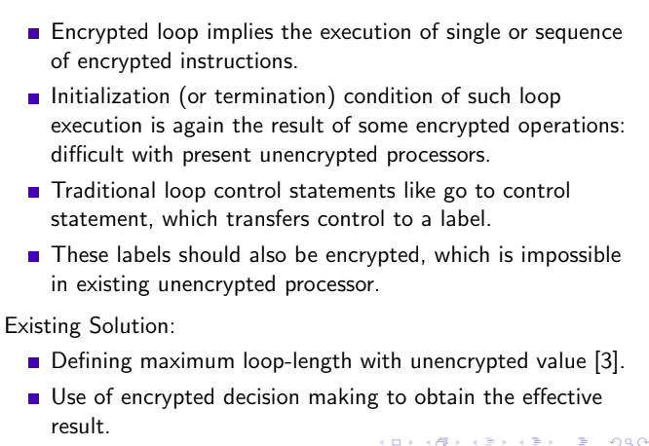
Few Challenges

Slide 27
Encrypted KNN Computation:
Ref: https://link.springer.com/content/pdf/10.1007/978-3-030-35869-3_13.pdf

Slide 28
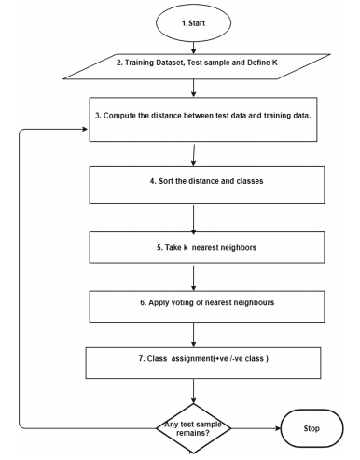
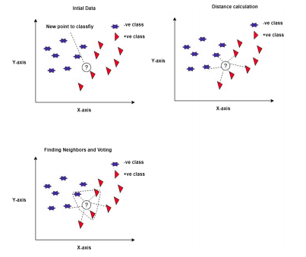
KNN Algorithm

Slide 29

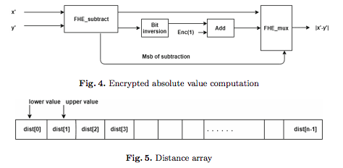

Distance Computation Step
Euclidean distance:
Manhattan distance:

Slide 30
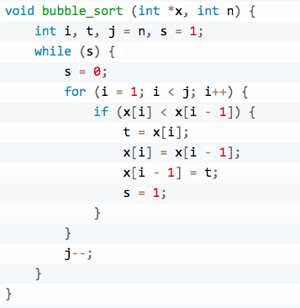
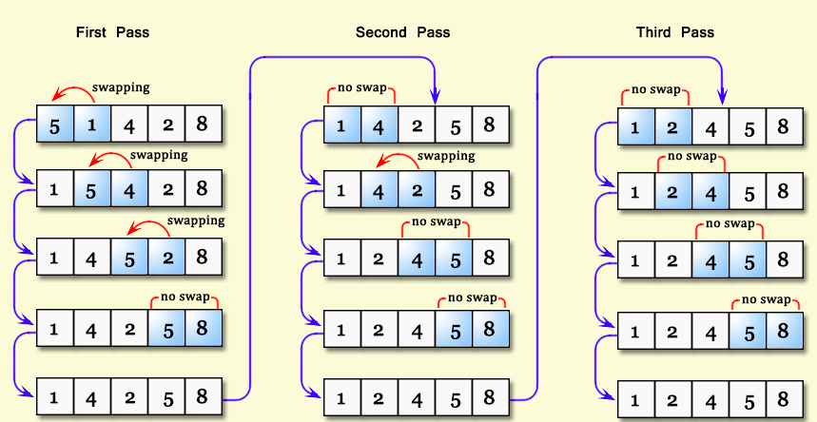
Sorting Step

Slide 31
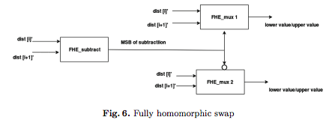
Sorting Step

Slide 32
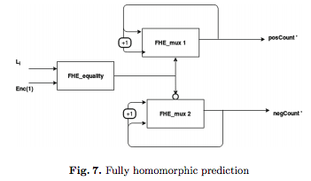
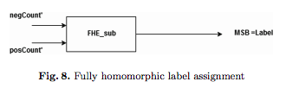
KNN Voting and Class Label Assignment

Slide 33
Implementation
Encrypted SVM Computation

Slide 34
Points to Ponder
How to compute the convolution?
How to compute the pooling layer?
Feasibility of encrypted activation functions.

Slide 35
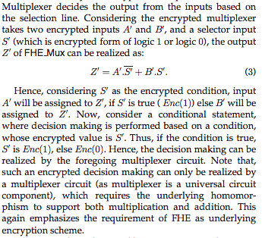
Key Observation
Encrypted decision making (encrypted multiplexer) improves feasibility, but deteriorates timing performance.
[In electronics, a multiplexer (or mux; spelled sometimes as multiplexor), also known as a data selector, is a device that selects between several analog or digital input signals and forwards the selected input to a single output line.
Mux operator design demands encrypted multiplication]
Try to reduce encrypted multiplication as far as possible by approximation to improve timing performance.

Slide 36
CryptoNets: Applying Neural Networks to Encrypted Data with High Throughput and Accuracy, 2016, https://proceedings.mlr.press/v48/gilad-bachrach16.pdf

Slide 37
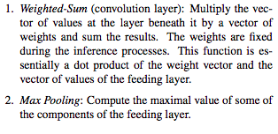
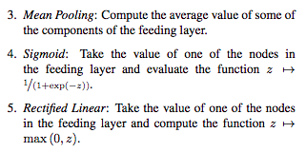
Common functions in NN

Slide 38
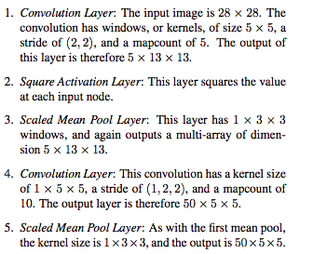
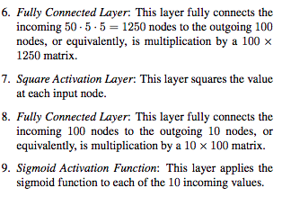
Tentative Size of Example NN

Slide 39
Revisit Convolution: Multiplication

Slide 40
Convolution Restriction
the multiplications here are between precomputed weights and the values of the feeding layer.
weights are not encrypted, it is possible to use the more efficient plain multiplication operation.

Slide 41
Leveled homomorphic encryption
Bootstrapping/ recrypt is costly - performance bottleneck in practical adaptation
allows adding and multiplying encrypted messages but requires that one knows in advance the complexity of the arithmetic circuit that is to be applied to the data.
In other words, this cryptosystem allows to compute polynomial functions of a fixed maximal degree on the encrypted data.
High degree polynomial computation requires the use of large parameters in the scheme, which results in larger encrypted messages and slower computation times.
Hence, a primary task in making practical use of this system is to present the desired computation as a low degree polynomial.

Slide 42
Open Challenge: 2. Private Model
Encrypted Private Model Private Data Approach still impractical in real time scenario.

Slide 43
Additional Ref
https://ieeexplore.ieee.org/stamp/stamp.jsp?tp=&arnumber=7274687

